Slide 1


Slide 2

Study of Water Scarcity Due to Climate Change
Rainwater Harvesting as a Solution for Regi Model Town Zones 3 & 4
Prepared from the provided data and sample presentation

Slide 3
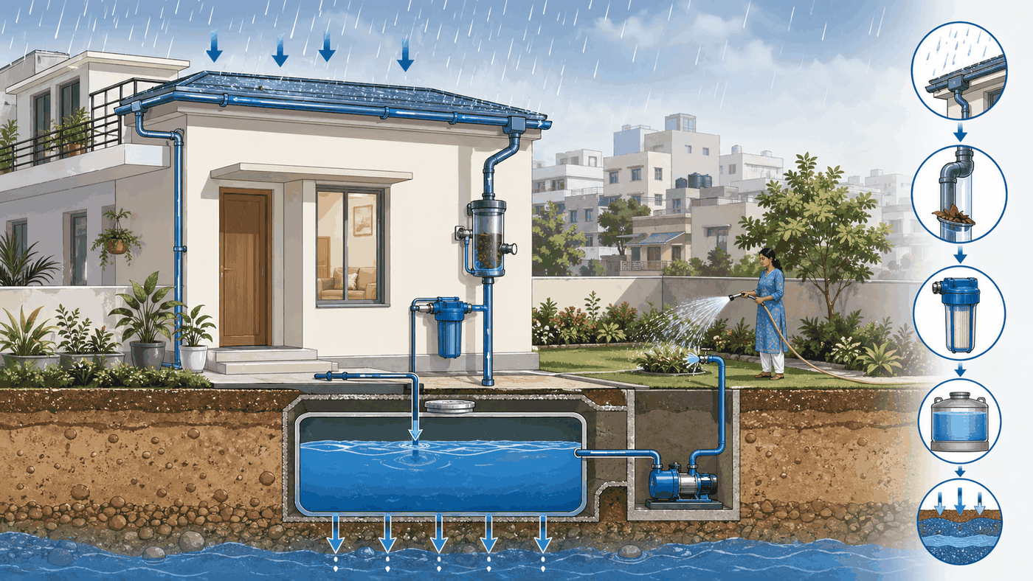
Project Team & Study Scope
Rainwater harvesting design for residential plots in Regi Model Town Zones 3 and 4.
Name | Reg. No. | Class No.
Hamid Ullah Khan | 22PWCIV5948 | 163(P)
Syed Sumair Ali | 22PWCIV5900 | 190(P)
Zabi Ullah Khan | 22PWCIV5814 | 31(U)
Muhammad Fazeel | 22PWCIV5896 | 181(P)
• Data-driven rainfall and IDF analysis
• Rooftop catchment calculations from Regi by-laws
• Practical pipe, filter and tank sizing
System concept for domestic non-potable water use
02

Slide 4
Why Rainwater Harvesting Matters
Urban water stress can be reduced by capturing seasonal rooftop runoff before it is lost as drainage flow.
Non-potable reuse
Zone 3 & 4
Design focus
Study site
• Reduces municipal demand for gardening and washing
• Provides local resilience during dry months
• Uses roof area already available within residential plots
Project intent: design a simple, maintainable and scalable RWH model for 5 Marla, 10 Marla and 1 Kanal plots.
03

Slide 5
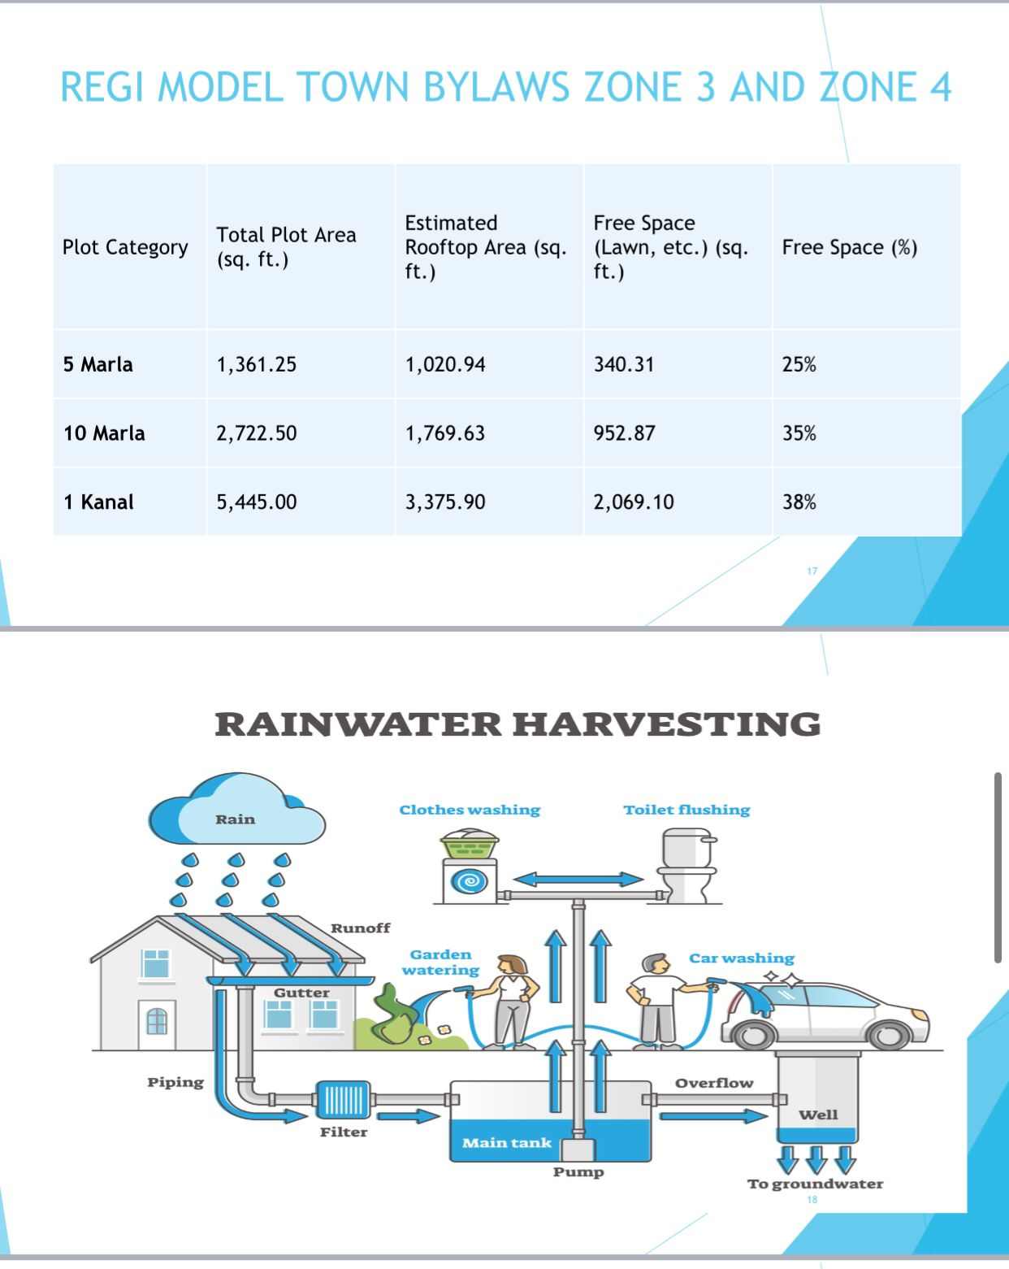
Study Area: Regi Model Town
Residential plots are assessed using the by-law roof and open-space proportions for Zones 3 and 4.
Plot category | Total plot area | Rooftop area | Free space
5 Marla | 1,361.25 ft² | 1,020.94 ft² | 25%
10 Marla | 2,722.50 ft² | 1,769.63 ft² | 35%
1 Kanal | 5,445.00 ft² | 3,375.90 ft² | 38%
• Rooftop area drives harvest volume
• Free space drives demand for irrigation
• By-laws support plot-wise sizing
By-law table used as the design basis
04

Slide 6
Objectives of the GCM Study
The project connects rainfall data, hydrologic calculations and practical system design.
• Analyze rainfall and rainfall intensity patterns for Peshawar
• Estimate rooftop rainwater harvesting potential for each plot size
• Design a safe pipe network for roof runoff conveyance
• Size storage, filtration, first-flush and overflow/recharge components
Deliverables: 30-slide presentation + GCM design report.
05

Slide 7
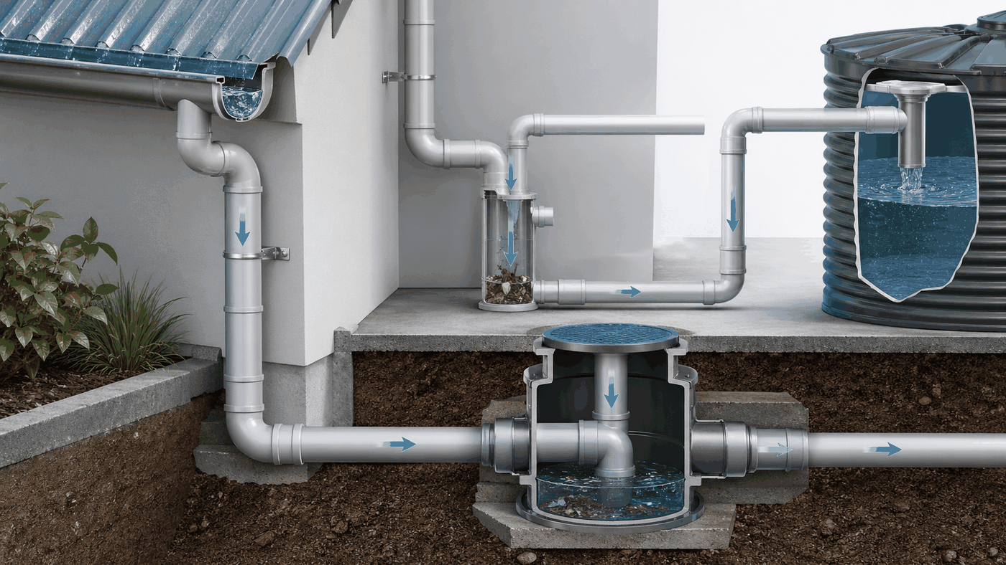
Methodology
A five-stage workflow converts rainfall records into practical system dimensions.
Data
Collection
Rainfall
Analysis
GCM
Calculations
Pipe
Design
Tank + Filter
Design
Methodology
06

Slide 8
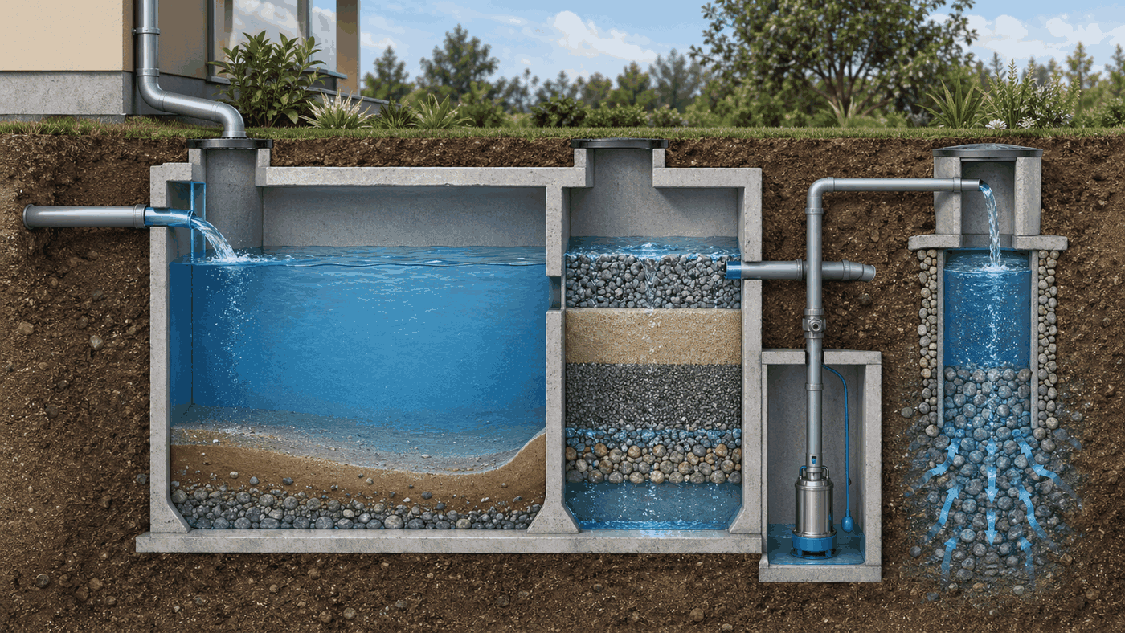
Data Sources & Design Assumptions
Assumptions are kept conservative for a residential roof-based harvesting system.
Input | Used in model
Peshawar rainfall data | Annual, monthly and intensity analysis
IDF Development Sheet | Design storm and pipe flow
Regi Model Town by-laws | Roof, plot and free-space areas
Runoff coefficient | 0.85 for roof catchment
First-flush depth | 1.0 mm of roof runoff
Filtration and storage elements are sized after first-flush separation
07

Slide 9
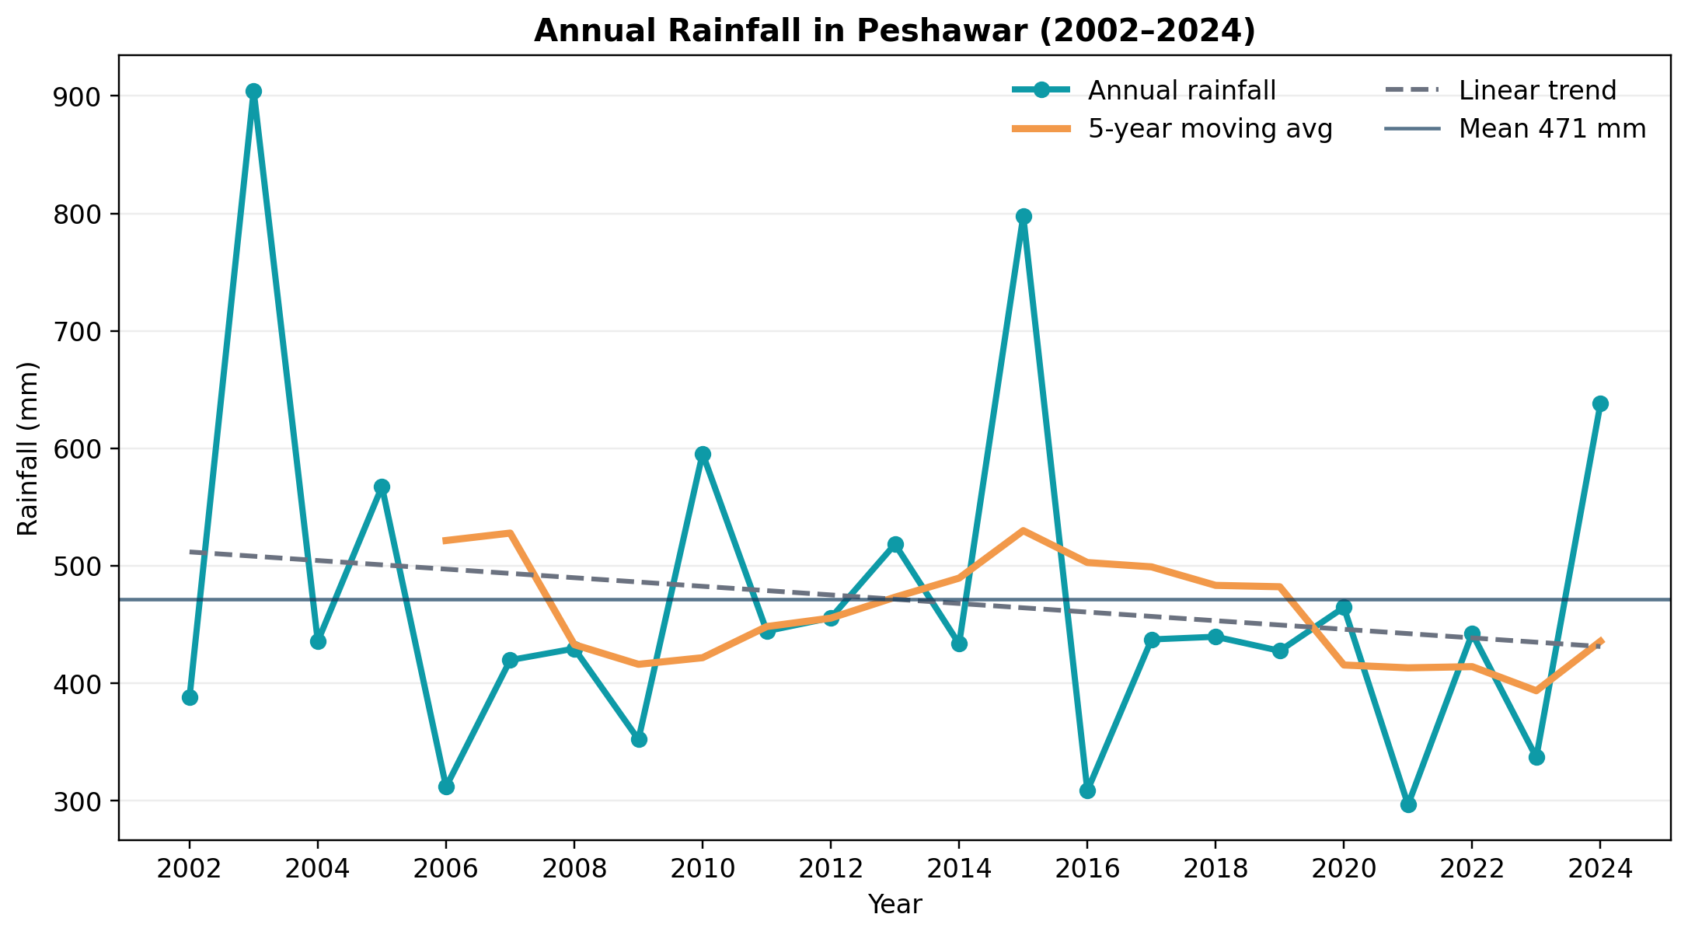
Rainfall Record: 2002–2024
The GCM model uses 23 years of annual rainfall values for trend, variability and yield calculations.
471 mm
2003
2021
31%
Mean annual rainfall
Wettest year
Driest year
Coefficient of variation
08

Slide 10
Annual Rainfall Trend
The rainfall record shows strong inter-annual variability, with extreme wet years and dry years.
• Average annual rainfall: 471 mm
• Maximum: 904.5 mm in 2003
• Minimum: 296.4 mm in 2021
• Linear trend: -3.7 mm/year
Design implication: storage and overflow should handle variability rather than depend on a constant yearly supply.
09

Slide 11
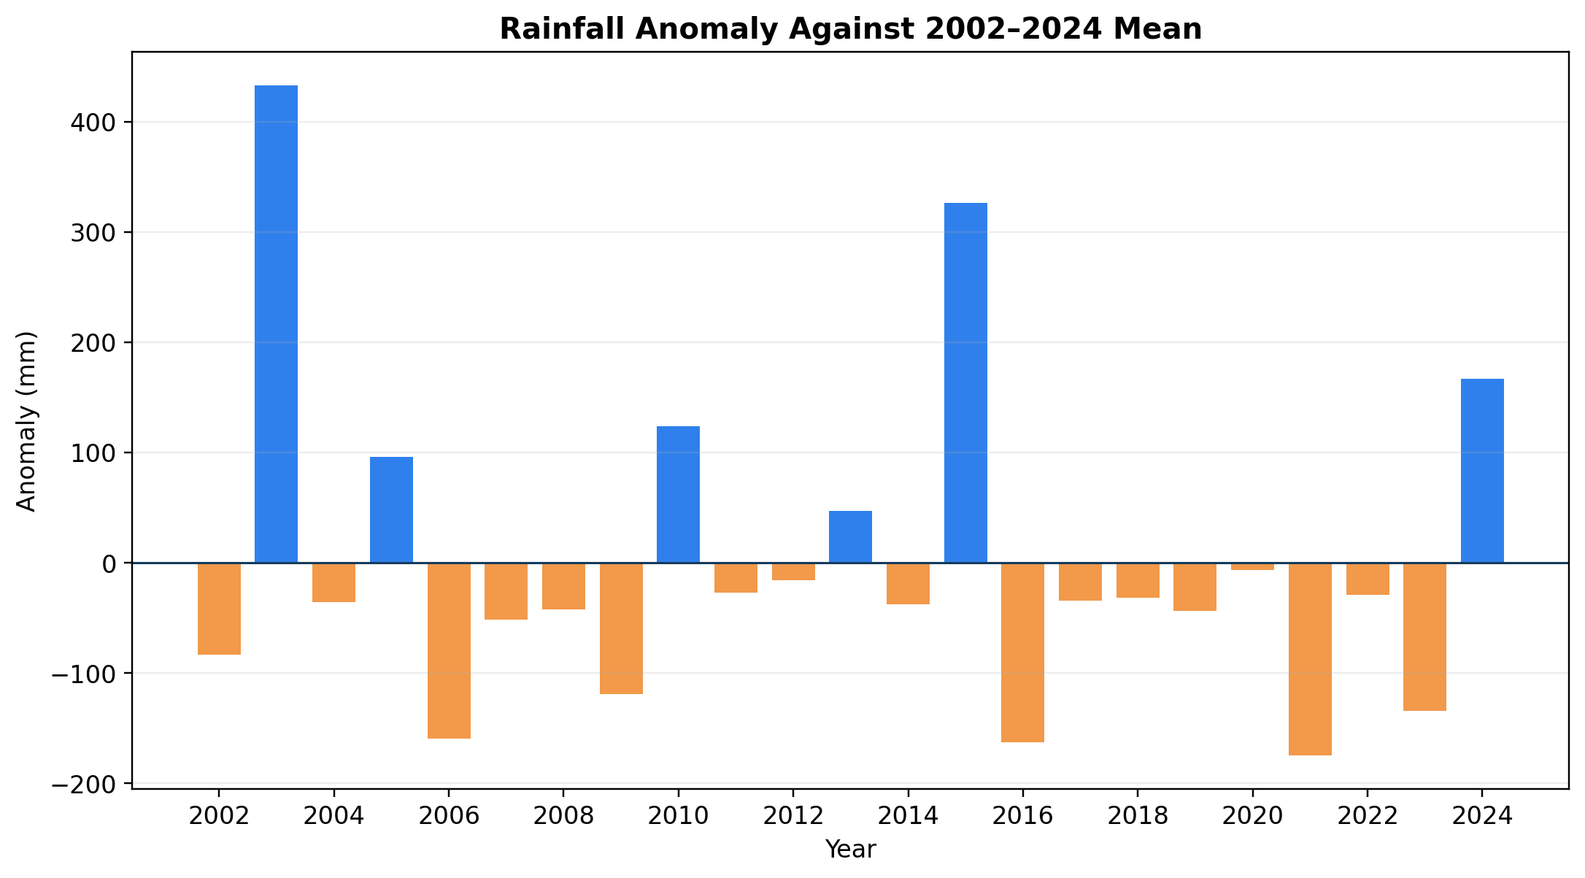
Rainfall Variability & Extremes
Anomaly analysis identifies how far each year moves above or below the long-term mean.
904.5 mm
Wettest year
296.4 mm
Driest year
148 mm
Std. deviation
10

Slide 12
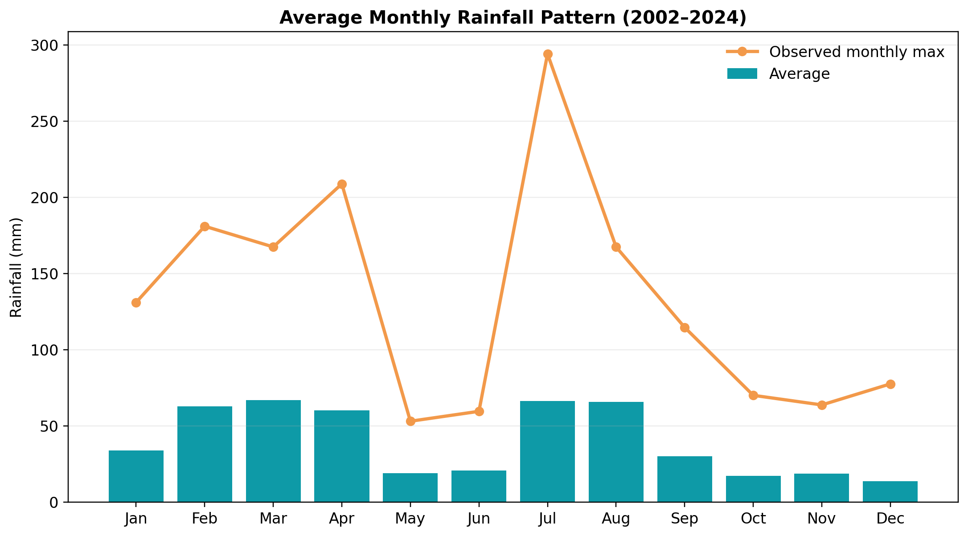
Monthly Rainfall Distribution
Peshawar rainfall is concentrated in spring and monsoon months.
• March–April: strong spring rainfall peak
• July–August: monsoon contribution and high intensity risk
• Dry months require storage carry-over or municipal backup
Highest monthly event in the series: July 2010 with 294.1 mm.
11

Slide 13
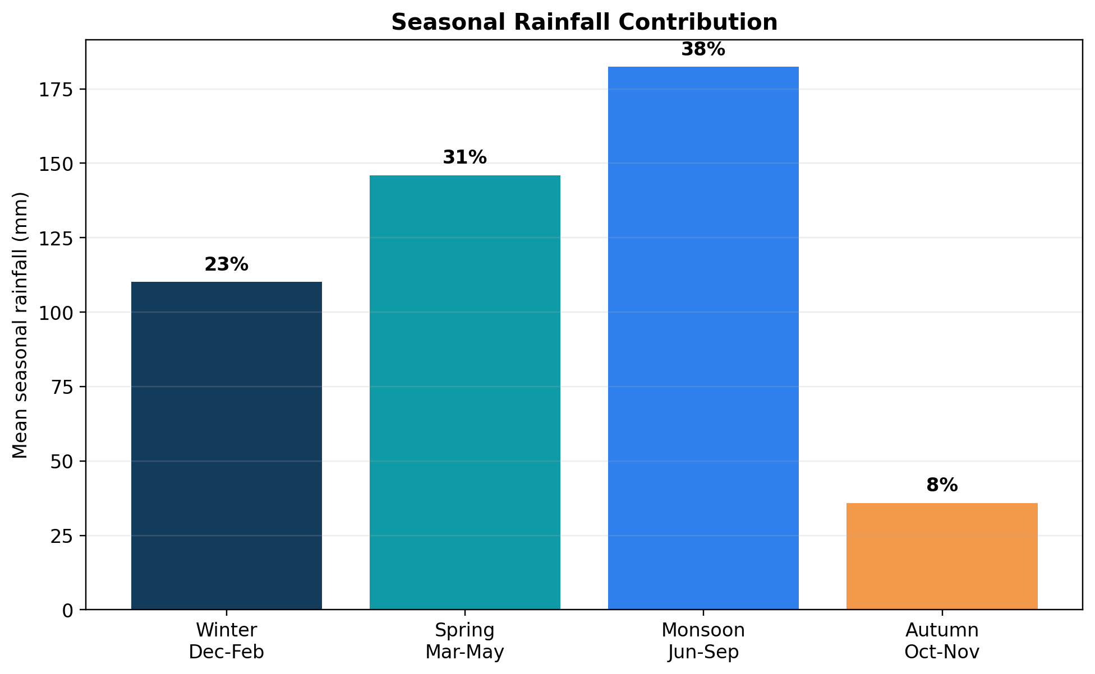
Seasonal Rainfall Contribution
Rainfall harvesting should be designed for two supply peaks: spring and monsoon.
Season | Mean rainfall | Share
Winter | 110 mm | 23%
Spring | 146 mm | 31%
Monsoon | 182 mm | 38%
Autumn | 36 mm | 8%
Monsoon events dominate peak runoff, while spring rainfall adds important annual supply.
12

Slide 14
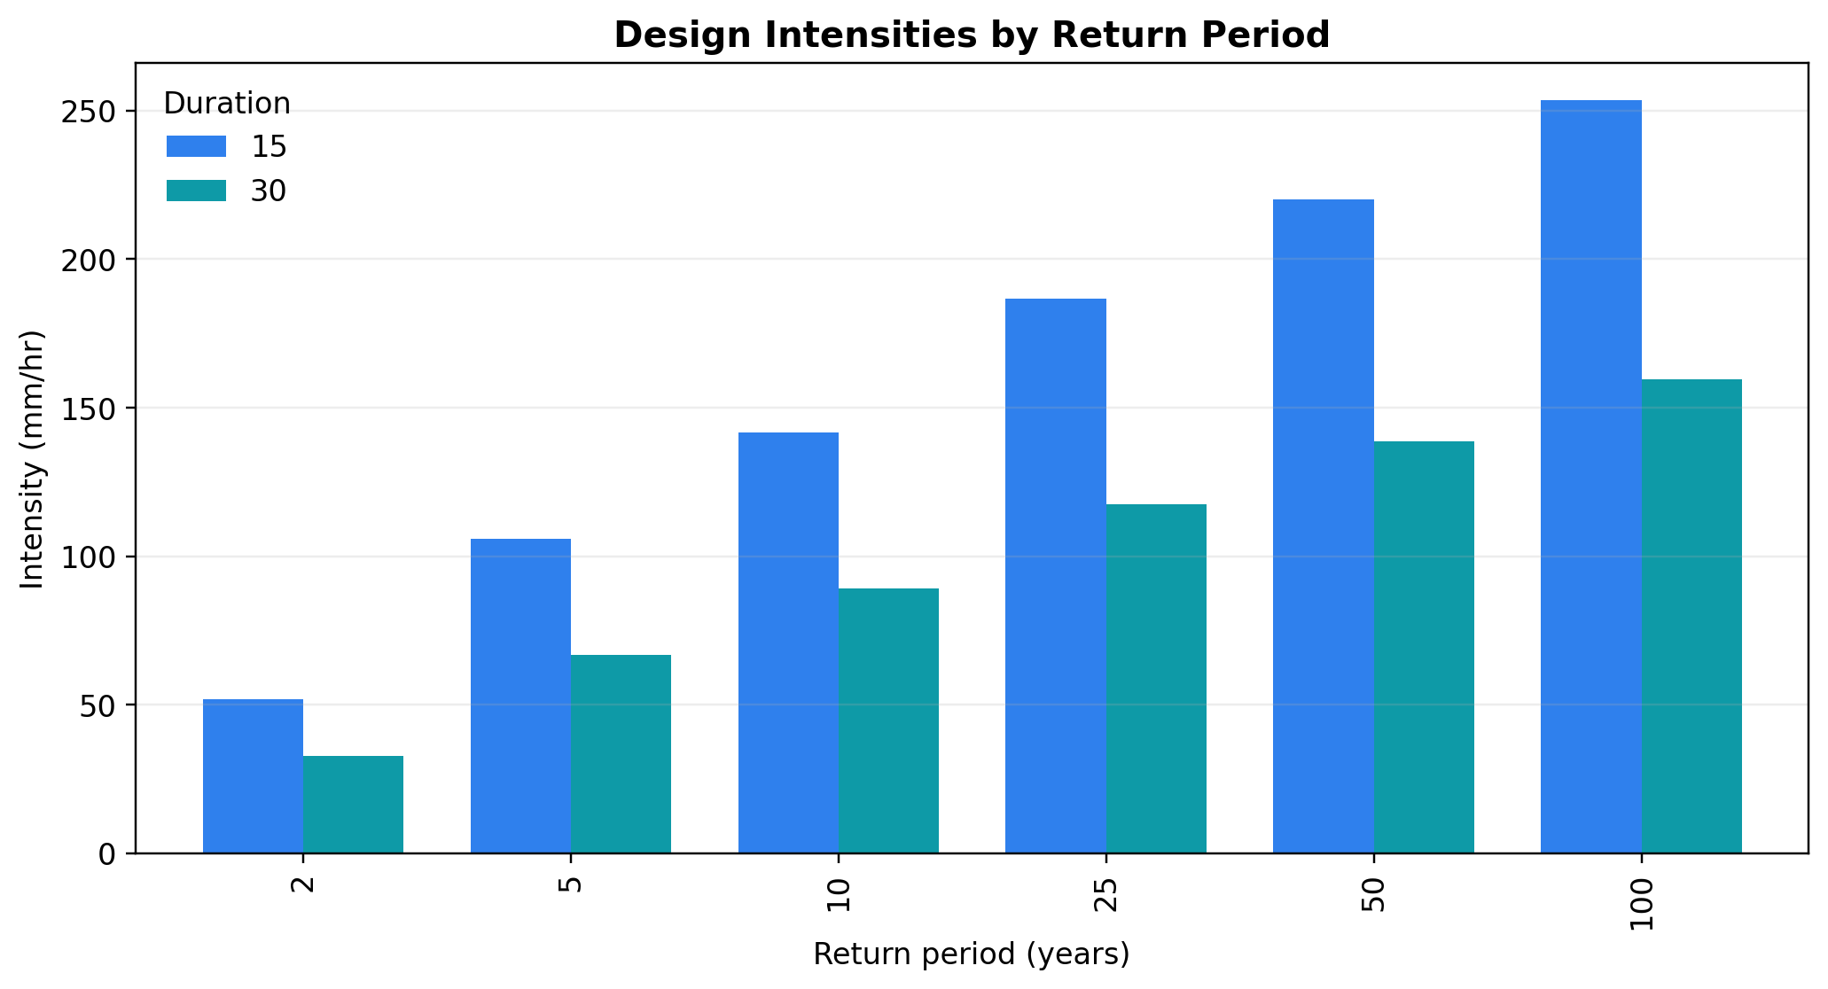
IDF Development Overview
Intensity–duration–frequency curves are used for pipe and overflow design.
• Short storm durations create the highest runoff rates
• Return period selection controls system conservatism
• Gutter, downpipe and overflow should be checked for 10-year, 15-minute intensity
141.6 mm/hr
10-year, 15-min intensity
13

Slide 15
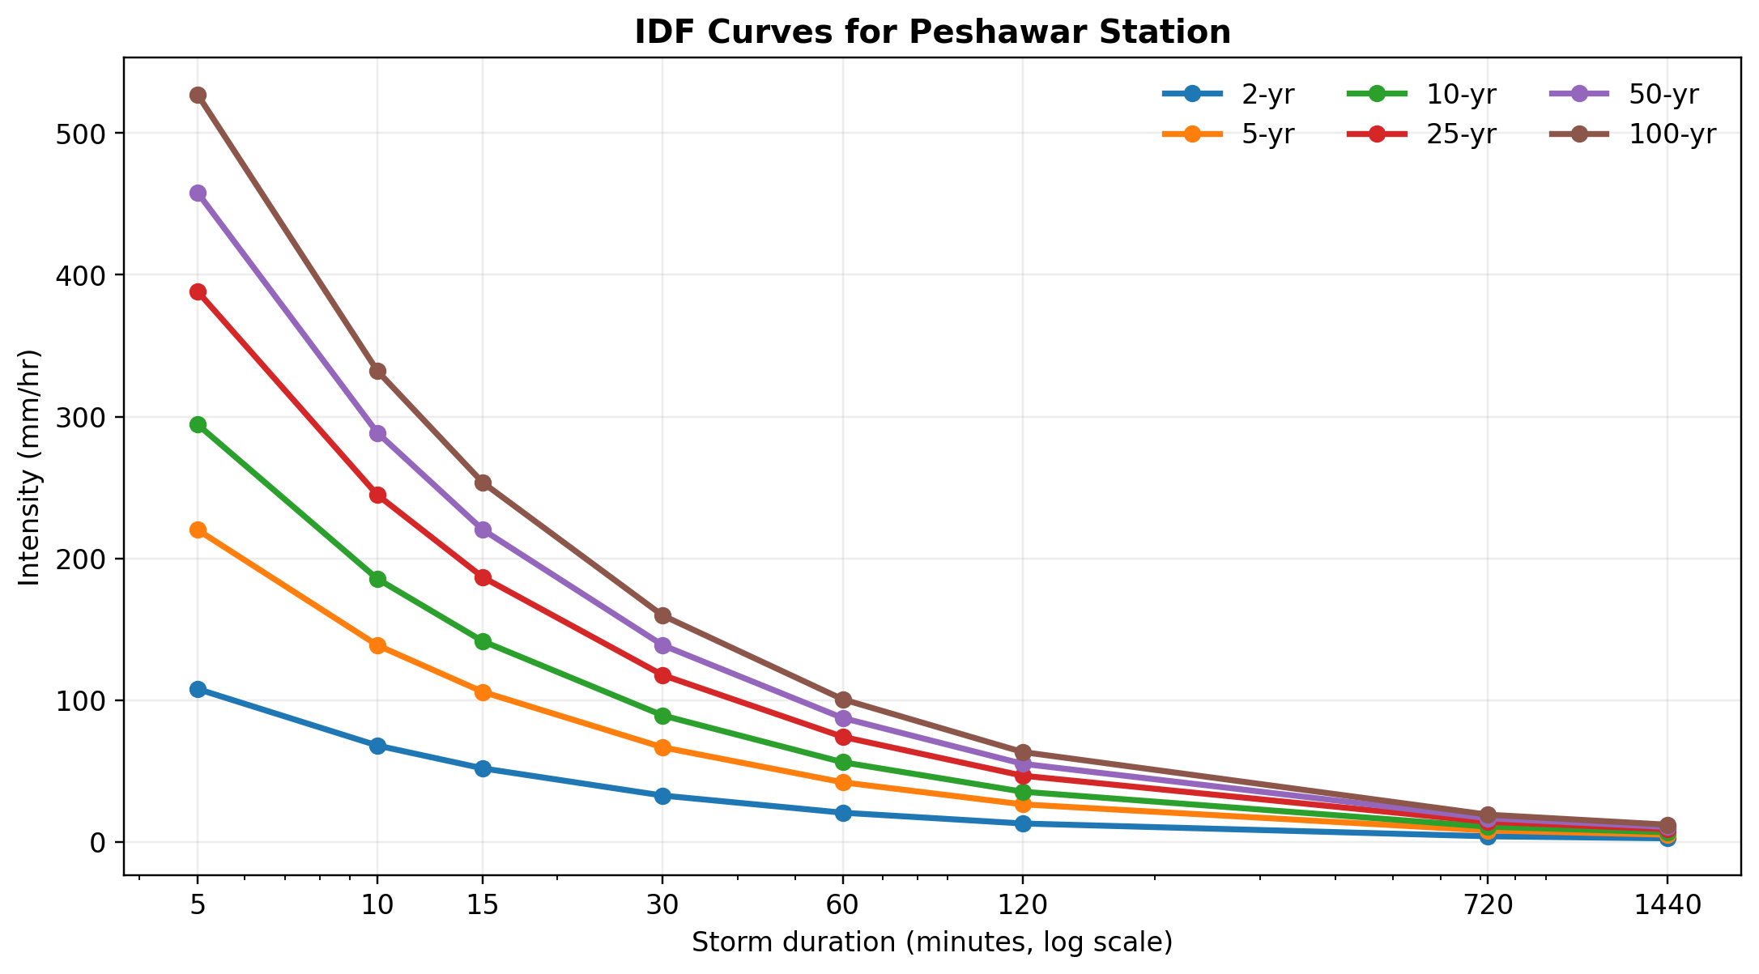
IDF Curves for Peshawar Station
Intensity drops quickly as storm duration increases.
Return period | 15-min | 30-min | 60-min
2 yr | 51.8 | 32.7 | 20.6
5 yr | 105.8 | 66.7 | 42.0
10 yr | 141.6 | 89.2 | 56.2
25 yr | 186.7 | 117.6 | 74.1
50 yr | 220.2 | 138.7 | 87.4
100 yr | 253.5 | 159.7 | 100.6
Units: mm/hr
14

Slide 16
Design Storm Selection
For residential roof drainage, the 10-year 15-minute storm is selected as the sizing check.
10-year
15 minutes
141.6 mm/hr
0.85
Selected storm
Duration
Intensity
Runoff coefficient
Q = C × i × A
Q = peak roof runoff, C = runoff coefficient, i = rainfall intensity, A = rooftop area
• Pipe design is based on peak flow, not annual rainfall volume
• Storage sizing is based on monthly/seasonal water balance
15

Slide 17
Rooftop Catchment From Regi By-laws
Rooftop area is converted from square feet to square meters for hydrologic calculations.
Plot | Roof area (ft²) | Roof area (m²) | Free space
5 Marla | 1,020.94 | 94.85 | 340.31 ft²
10 Marla | 1,769.63 | 164.40 | 952.87 ft²
1 Kanal | 3,375.90 | 313.63 | 2,069.10 ft²
Larger roofs generate higher annual yields and higher peak runoff; therefore they need larger tanks and stronger overflow control.
Catchment sizing
16

Slide 18
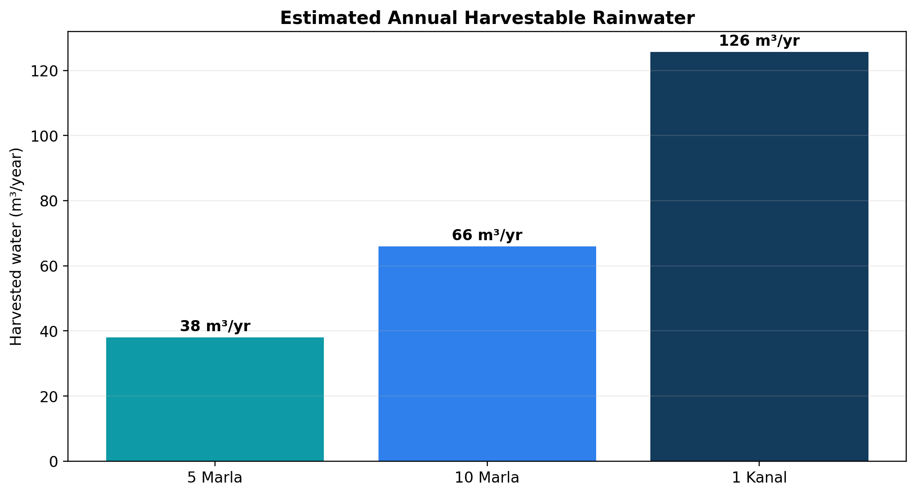
Estimated Annual Harvestable Rainwater
Harvest volume is calculated using mean annual rainfall, roof area and roof runoff coefficient.
Plot | Annual yield | Approx. liters/year
5 Marla | 38.0 m³ | 38,000 L
10 Marla | 65.9 m³ | 65,900 L
1 Kanal | 125.7 m³ | 125,700 L
These volumes are suitable for gardening, floor washing, car washing and toilet flushing after filtration.
17

Slide 19
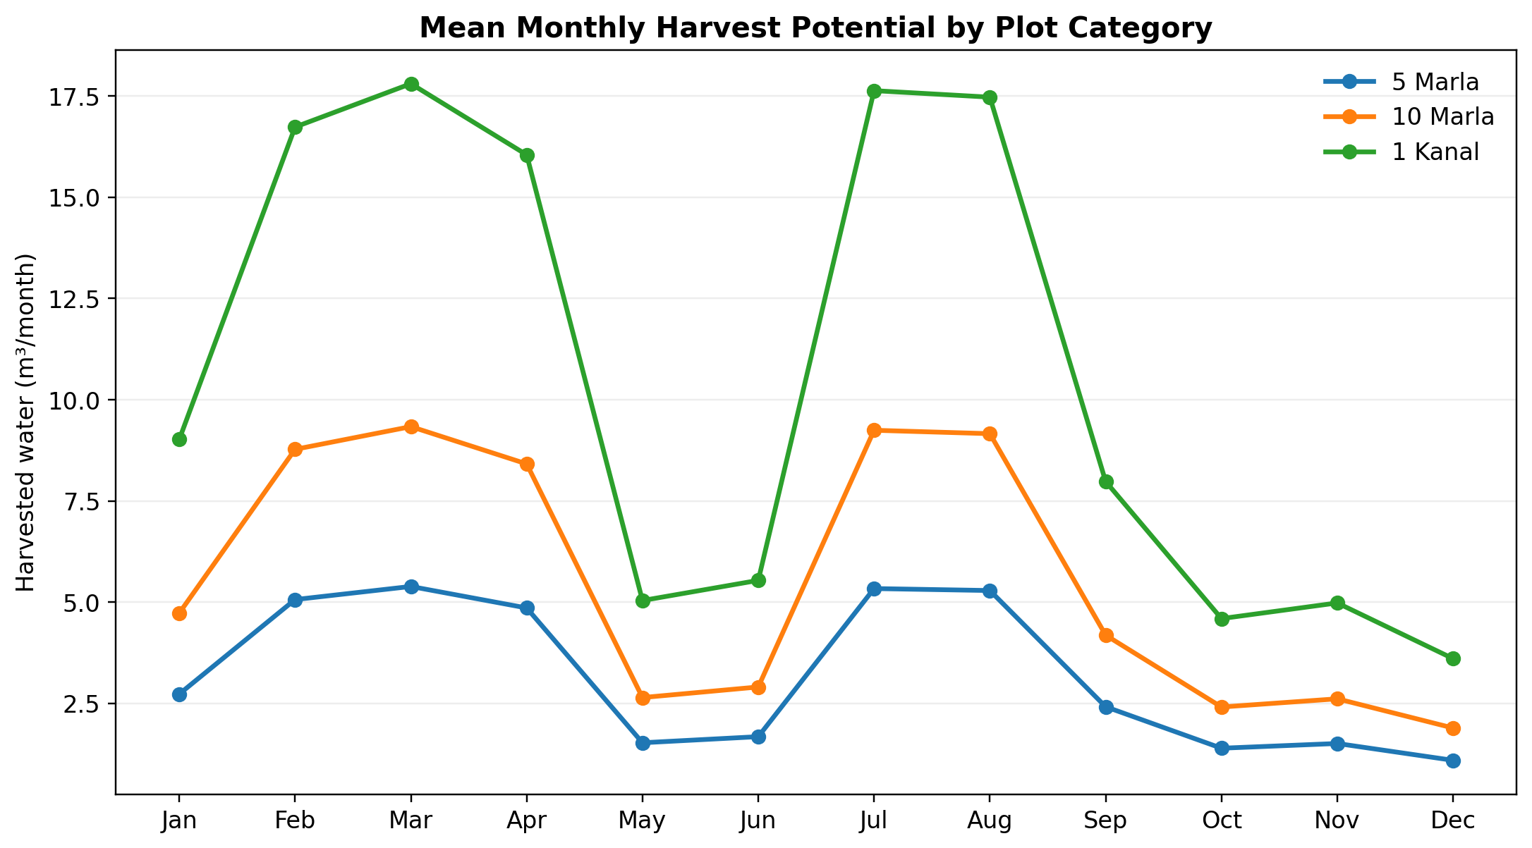
Monthly Harvest Potential
Monthly water availability follows rainfall seasonality; tanks should capture spring/monsoon surplus.
• Highest supply months: February–April and July–August
• Low supply months: October–December and May–June
• Larger plots show more reliable non-potable supply
18

Slide 20
Demand–Use Match
Harvested rainwater should first serve demands that do not require potable quality.
Use | Priority | Treatment need
Garden watering | High | Screen + storage
Car/floor washing | High | Filter + first flush
Toilet flushing | Medium | Filter + disinfection optional
Recharge well | Overflow | Silt removal required
Recommended operation: use the tank for routine non-potable demand and route excess stormwater to recharge after filtration.
19

Slide 21
GCM Calculation Framework
The GCM converts rainfall inputs into design outputs through four calculation blocks.
Rainfall
Intensity
Calculation
Analysis
Pipe
System
Tank
Design
IDF return period + duration
Yield, peak flow, water balance
Gutters, downpipes, collectors
First flush, filter, storage, overflow
Core formulas
V = P × A × C Q = C × i × A Vff = 1 mm × A
V = volume, P = rainfall depth, A = roof area, C = runoff coefficient, i = intensity, Vff = first-flush volume
20

Slide 22
Pipe System Design Basis
Pipe capacity is checked against peak roof runoff during a short-duration design storm.
Design parameter | Value
Return period | 10 years
Storm duration | 15 minutes
Rainfall intensity | 141.6 mm/hr
Roof coefficient | 0.85
Pipe material | uPVC / HDPE
Minimum slope | 1:200 to 1:300
21

Slide 23
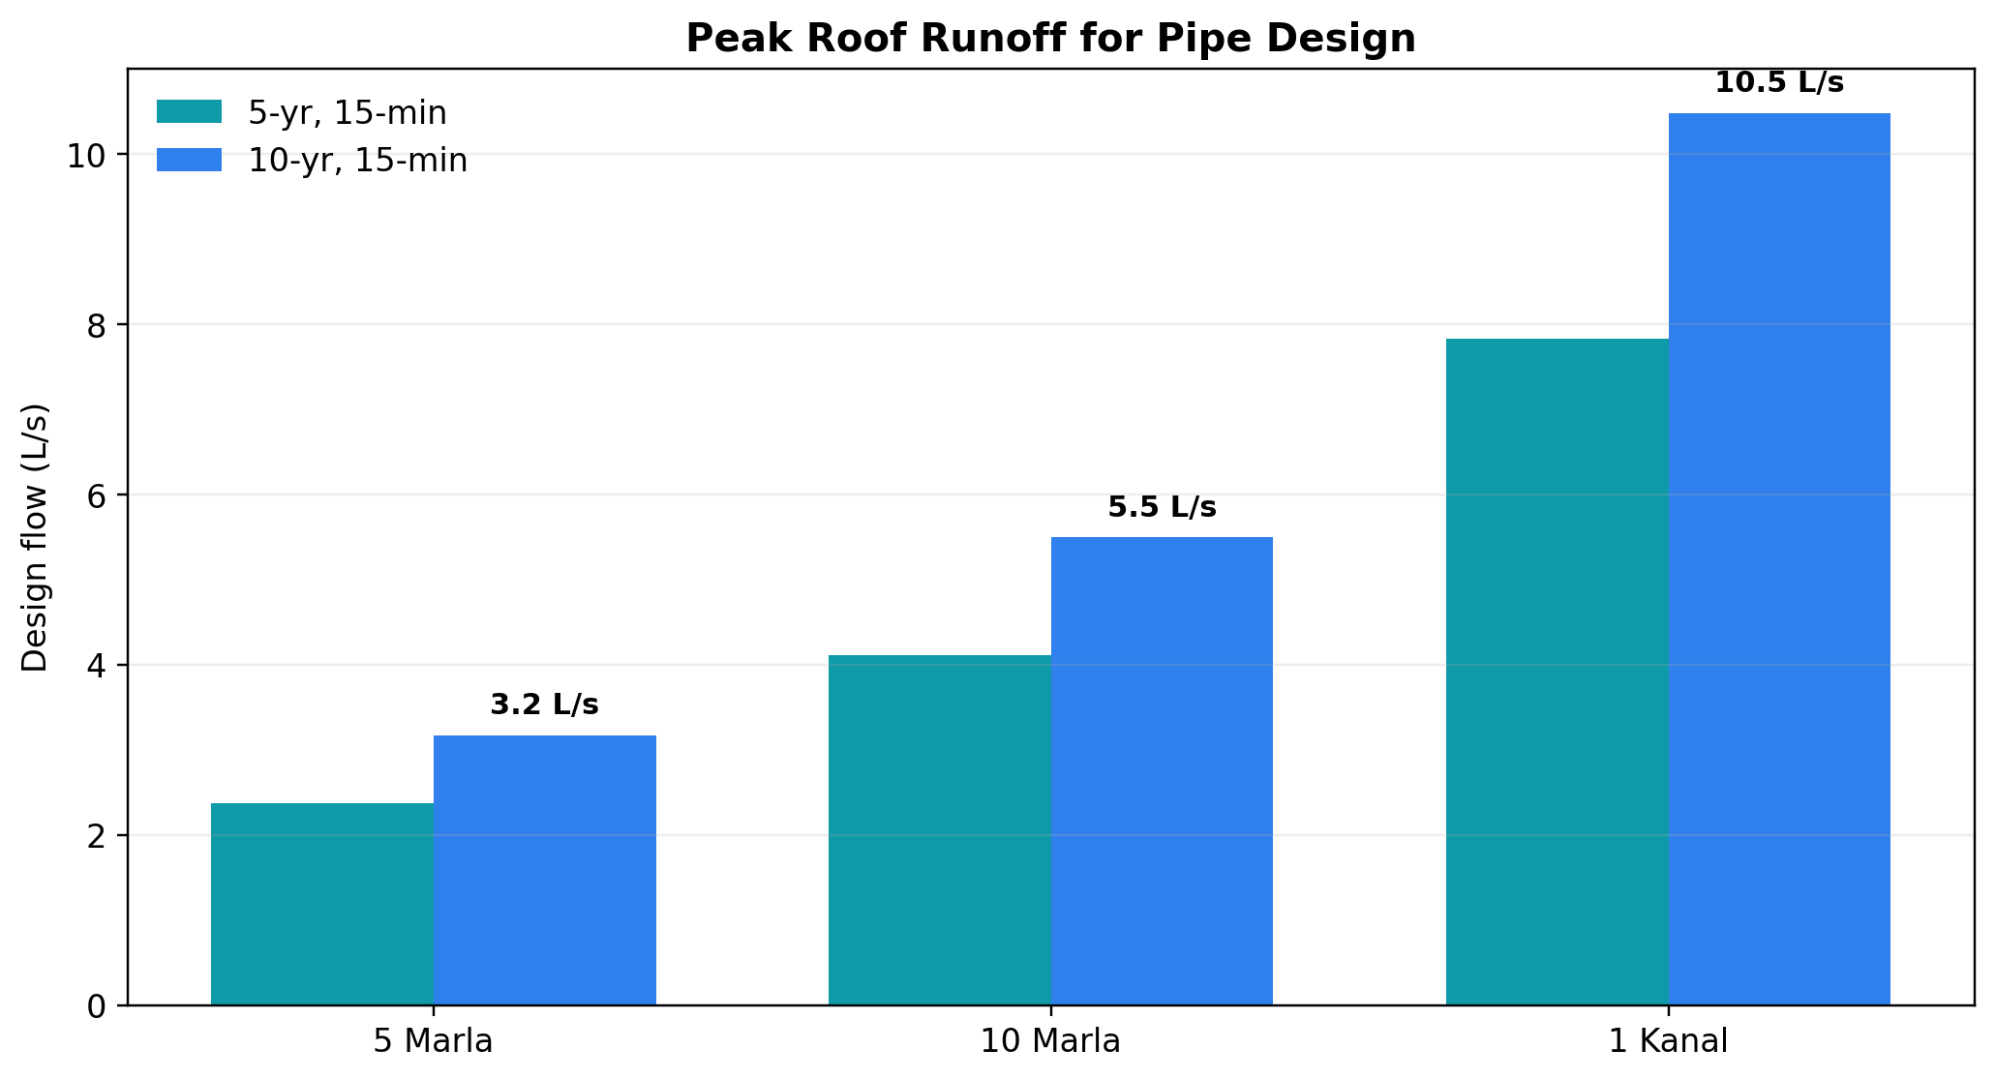
Peak Flow & Pipe Sizing
Peak flow increases with rooftop area; pipe layout should split flow across multiple downpipes.
Plot | Q10 peak | Suggested main collector
5 Marla | 3.17 L/s | 110 mm
10 Marla | 5.49 L/s | 160 mm
1 Kanal | 10.48 L/s | 200 mm or 2×160 mm
Use at least two downpipes per roof face where practical; add clean-outs at bends and before the filter chamber.
22

Slide 24
Recommended Pipe Layout
The layout separates roof capture, first-flush diversion, filtration and tank inflow.
• Gutters sized with freeboard and leaf guards
• Downpipes at corners to reduce roof ponding
• First-flush diverter before filter chamber
• Overflow line routed to recharge/soak pit
Suggested detailing: removable screens, access covers, non-return valves, and silt traps at low points.
23

Slide 25
First-Flush & Filtration Design
Initial roof runoff is diverted before water enters the storage tank.
Plot | First-flush volume | Filter chamber
5 Marla | 95 L | 1.0 × 0.6 × 0.8 m
10 Marla | 164 L | 1.2 × 0.8 × 0.9 m
1 Kanal | 314 L | 1.5 × 1.0 × 1.0 m
• Filter layers: gravel, coarse sand, fine sand and charcoal
• Provide drain valve for maintenance
• Clean media after major storms
24

Slide 26
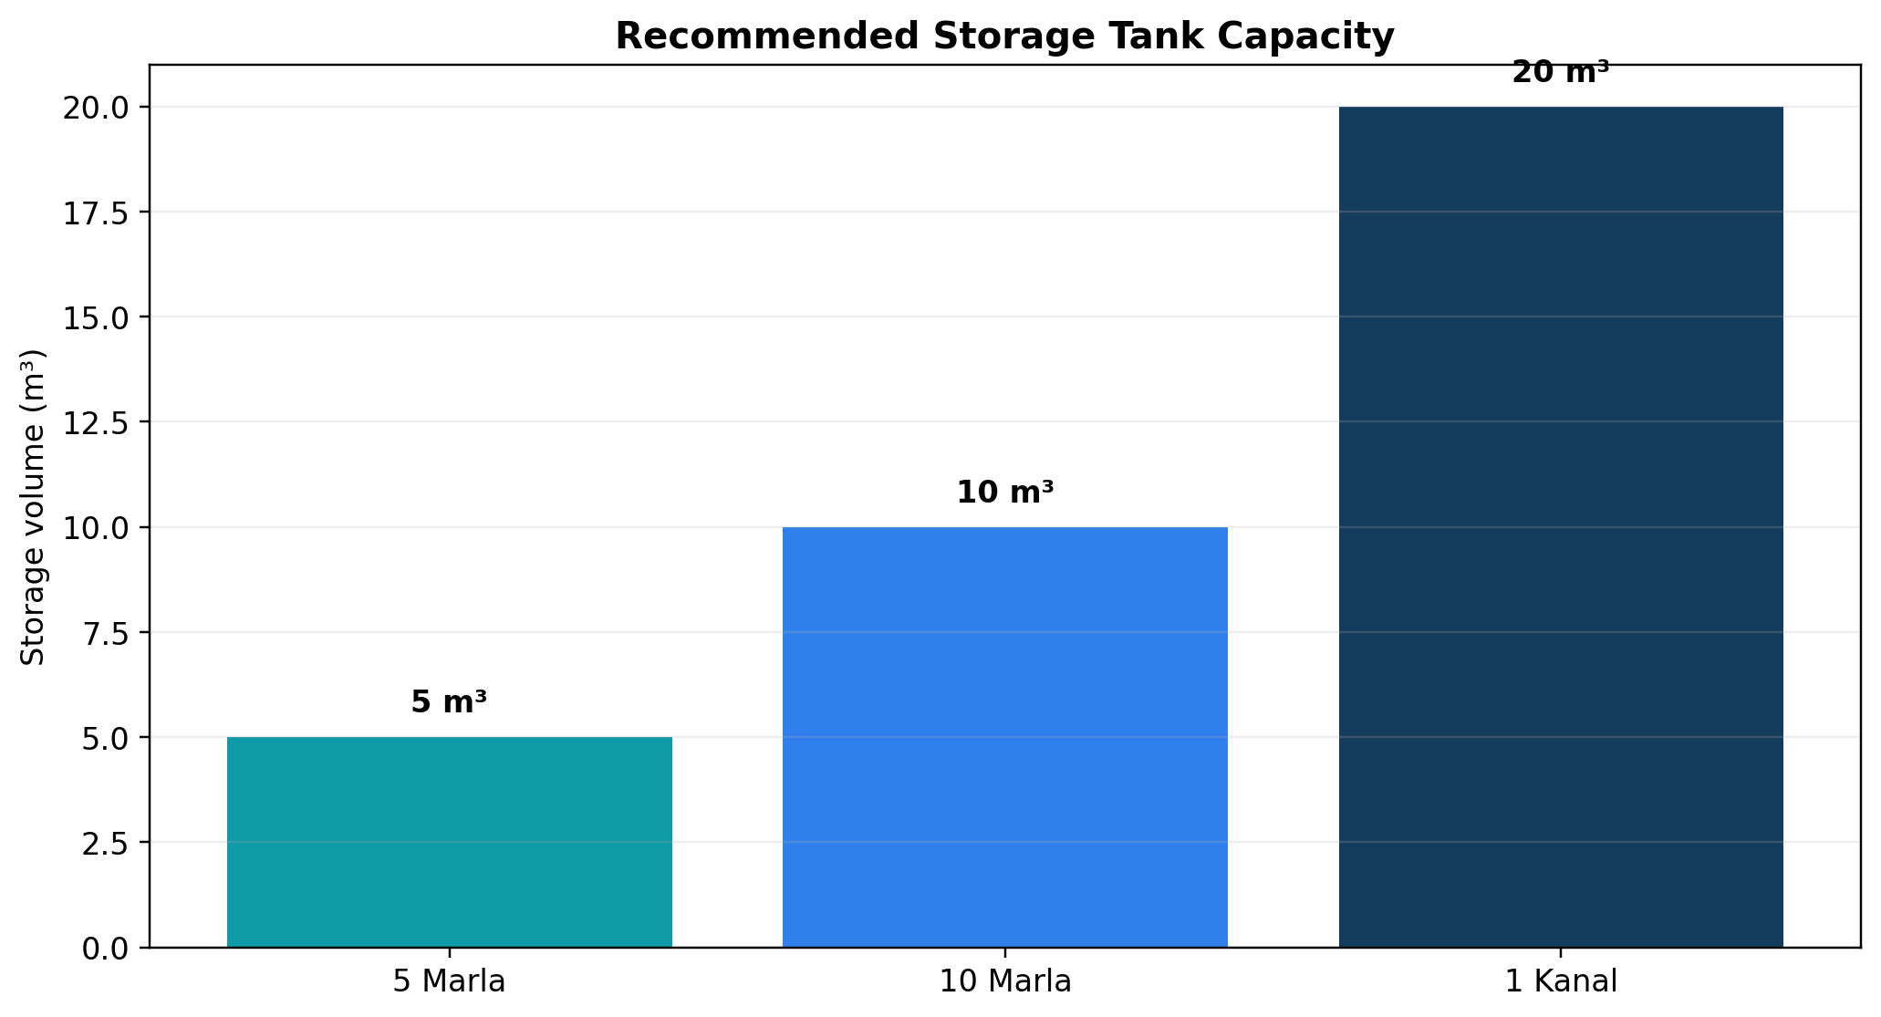
Storage Tank Sizing
Storage is selected to capture usable stormwater while staying practical for plot-scale installation.
Plot | Recommended tank | Annual yield share
5 Marla | 5 m³ | 13%
10 Marla | 10 m³ | 15%
1 Kanal | 20 m³ | 16%
Sizing logic: choose an affordable tank that can store several weeks of non-potable demand and is easy to clean.
25

Slide 27
Storage & Filtration Tank Designs
RCC underground tanks are preferred for durability; modular HDPE tanks can be used where excavation is limited.
Plot | Tank volume | Typical internal dimensions
5 Marla | 5 m³ | 2.2 × 1.5 × 1.5 m
10 Marla | 10 m³ | 3.0 × 2.0 × 1.7 m
1 Kanal | 20 m³ | 4.0 × 2.5 × 2.0 m or 2×10 m³
• Watertight RCC/HDPE tank with access cover
• Calmed inlet to reduce sediment disturbance
• Pump chamber or gravity outlet depending on plot levels
26

Slide 28
Overflow & Groundwater Recharge
Overflow should be treated as a design component, not an afterthought.
• Overflow pipe should be at least equal to inlet size
• Route overflow through silt trap before recharge well
• Use gravel-filled recharge pit where soil infiltration allows
• Provide inspection chamber and mosquito-proof venting
Recharge protects the site from surface ponding and supports long-term groundwater conservation.
27

Slide 29
Operation & Maintenance Plan
A simple maintenance routine keeps harvested water usable and avoids blockages.
Frequency | Action
Before monsoon | Clean roof, gutters and screens
After first heavy rain | Empty first-flush chamber
Monthly | Inspect filter and pipe clean-outs
Quarterly | Remove tank sediment if visible
Annually | Disinfect tank and service pump
O&M note: filtration media should be replaceable without breaking the tank structure.
28

Slide 30
Key Findings & Recommendations
The GCM confirms that plot-scale rainwater harvesting is technically feasible for Regi Model Town.
38–126 m³
3.2–10.5 L/s
5–20 m³
95–314 L
Annual harvest range
Design flow range
Tank range
First flush range
• Adopt 10-year, 15-minute storm for roof drainage checks
• Install leaf screens, first-flush diverter and graded filter before storage
• Use overflow/recharge pit to reduce drainage load
• Prepare plot-wise drawings before construction and verify soil infiltration
Next step: site survey and final construction drawings for each plot size.
29

Slide 31
THANK YOU
Questions & Discussion

